Slide 1

CAFÉ Assembly
October 6, 2021
Katy Mathias
CFA Secretariat

Slide 2




Project Timeline
Task Force Formed
October 2017
March 2019
Merger of Practice Stds and 10 Year Review projects
Launch of Consultant TOR
June 2019
August 2019
Wolfs Co/Aligning Visions Hired
Launch of Practice Standards
October 2020
PS Webinar Series Begins
January 2021
November 2020 Launch of 10-Year Review

Slide 3









Thank you to our donors

Slide 4
Thank you to the Task Force
María Luisa Hernández and Zdenka Piskulich (Asociación Costa Rica por Siempre)
Bryna Griffin (BirdLife/Trillion Trees)
Pema Choephyel (Bhutan Trust Fund for Environmental Conservation)
Yabanex Batista and Karen McDonald Gayle (Caribbean Biodiversity Fund)
David Meyers (Conservation Finance Alliance)
Veronica Chang, Judith Reyes, Andrew Schatz and Christopher Stone (Conservation International)
Camila Monteiro (Convergencia Sustentabilidade)
Fenosoa Andriamahenina (Fundação BioGuine)
Lorenzo J. de Rosenzweig and Karina Ugarte (Terra Habitus A.C.)
Mark Zimsky (Global Environment Facility)
María José González (Mesoamerican Reef Fund)
Carl Bruessow (Mulanje Mountain Conservation Trust)
Robbie Bovino and Munira Bashir (The Nature Conservancy)
Stuart Dainton (World Wildlife Fund-UK)
Melissa Moye (World Wildlife Fund-US)
Ray Victurine, Tom Clements, and Katy Mathias (Wildlife Conservation Society)
Scott Lampman (United States Agency for International Development)
Thanks also to the CFA’s Environmental Funds Working Group
and the CTIS Advisory Committee for input and review

Slide 5
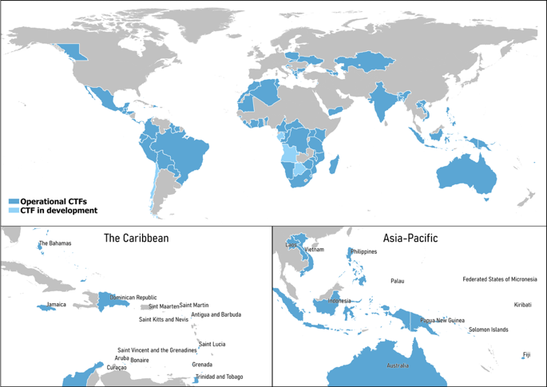

108 worldwide
20-30 Years of operation
40 new since 2010
14 closed
Nearly USD$2 billion in invested assets
Source: Conservation Trust Funds 2020: Global Vision, Local Action. Conservation Finance Alliance.
Notes:
KATY)

Slide 6
Why Practice Standards?
Align with donor expectations for transparency and accountability
Help CTFs to improve efficiency and effectiveness
Support accreditation to multilateral agencies
Share knowledge across CTFs from different regions and stages of development
Speed up the learning curve

Slide 7
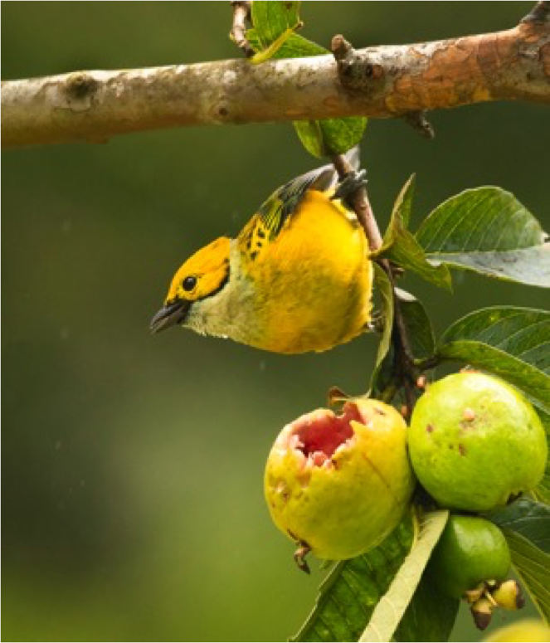
Goals for the Update
Voluntary
A tool for the design, management, and evaluation of CTFs
Serve CTFs and funders
Continue raising the bar
Photo by Paquita Bath

Slide 8

Build on 2014 Practice Standards
Maintain organizing principles
Add new Standards in key areas requested by CTFs
Edit some existing Standards based on input from CTFs, funders and experts
Regroup some of the Core Areas and Standards
Highlight Cross-cutting Themes
Notes:
Organizing principle like Reason for the Standard, Practical Considerations, Evidenced by.
Regroup was Operations splitting Instit Effectiveness and Programs (more than grant making)

Slide 9

Align with the 10-Year Review
Evolution of CTFs and roles
Vocabulary
  Program Accounts
Emphasize independence
Innovations
  Private sector engagement
  Accreditation
  Risk Management
  SDGs
  Virtual meetings
  Mission Alignment of Investments

Slide 10
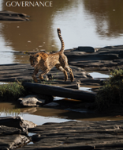
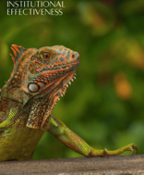
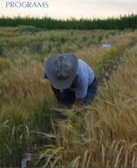
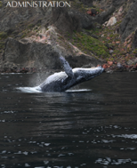
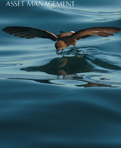
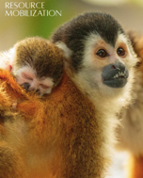
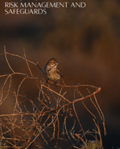
Standards are organized into seven Core Areas

Slide 11
7 Core
Areas
Governance
Institutional Effectiveness
Programs
Administration
Asset Management
Resource Mobilization
Risk Management and Safeguards
4 Cross-cutting Themes
Communications
Human Resources
Technology
Monitoring and
Evaluation
19 new standards

Slide 12
Some original groupings were re-aligned
Institutional Effectiveness
Operations
Resource Mobilization
Reporting, Monitoring & Evaluation
Programs

Slide 13
New core area: Risk Management and Safeguards (7 Standards)
Themes
Policies and procedures needed to identify and address risks and adopt national and internationally used environmental and social safeguards
Accreditation
ESIA – Environmental and Social Impact Assessment
Conflict of interests
Anti-Money Laundering
FPIC
Gender mainstreaming
Whistleblower protections

Slide 14
Communications theme (7 Standards)
  Report and disseminate information about the CTF to key audiences and media.
2014 Standards – report to different audiences, convey values and program goals, and comply with donor reporting requirements.
Additions – Staff delegation, internet presence, comprehensive communications policy.

Slide 15
Human Resources theme (12 Standards)
Full time CEO
HR policies conform to country laws
How CTFs organize and support staff to advance the mission and goals of the organization
Clear org charts
Clear annual goals and performance reviews
Safety and well-being of staff members
Protect whistle-blowers

Slide 16
Technology theme (7 Standards)
Cybersecurity
Internet presence
Standardize operations
Up-to-date software for key functions
Internal controls and policies to manage technology use, increase efficiencies, and minimize risks in this digital age
Notes:
Key functions such as financial administration, contract management, procurement etc.)

Slide 17

Asset Management
10 standards covering:
Investment policies and guidelines
Fiduciary duties and capital preservation
Expertise, roles and responsibilities of governing bodies and committees
Engagement of/with investment professionals
Mission alignment of investments - NEW
Notes:
Key functions such as financial administration, contract management, procurement etc.)

Slide 18
Annexes
List of cross-cutting themes.
Prioritizing Standards at different stages of CTF evolution!
Transposition table between 2014 and 2020
Assessing CTF’s use of the Standards
Glossary in one place

Slide 19
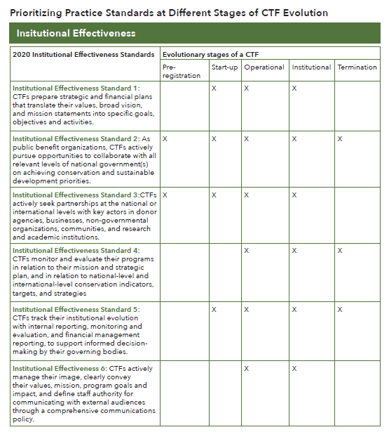
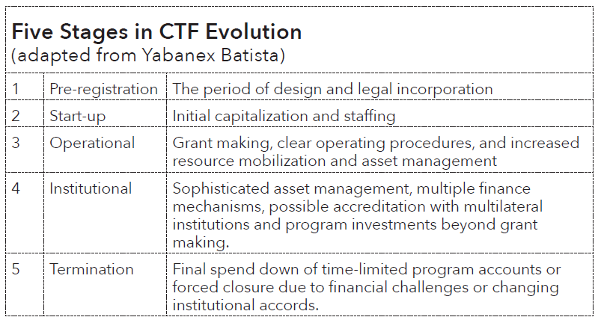
Annex 1
Prioritizing Standards at different stages of CTF evolution!

Slide 20
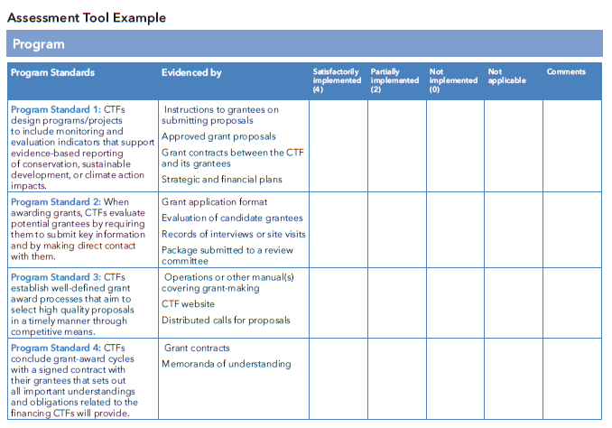
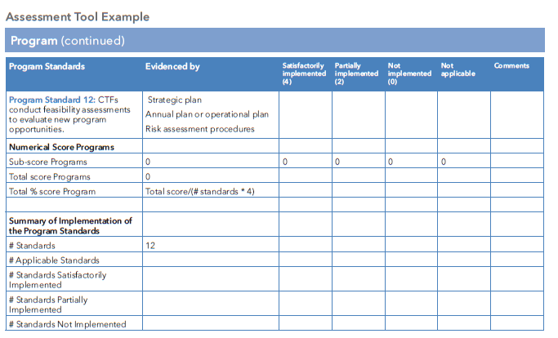
Annex 2
Assessing CTF’s use of the Standards

Slide 21
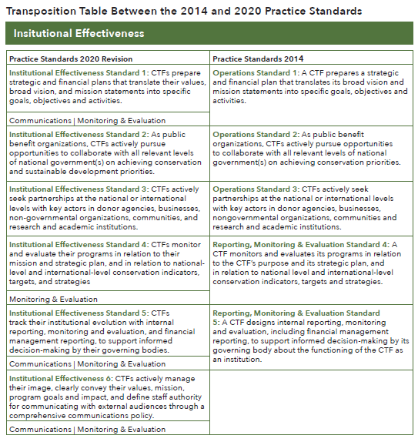
Annex 4
Transposition table between 2014 and 2020

Slide 22

Standards reinforce the importance of CTF reputation and work quality
Help nations implement the SDGs, Climate Agreements and other international commitments
Link global resources with local capacity
Accelerate use of new financial mechanisms for transformative land- sea-scale work
Understand money and can project the financing needed
Help fill the huge biodiversity funding gap with their experience to date
Notes:
Speaker: Paquita
Interdependent crises of biodiversity loss, ecosystem degradation and climate change – -- immediate link to human well being. 30% of the planet by 2030

Slide 23

Webinar Series
  General Overview
  Programs and Monitoring & Evaluation
  Communications
  Administration and Human Resources
  Resource Mobilization
  Asset Management
  Technology
  Governance and Institutional Effectiveness
  Using the Standards: Accreditation
conservationfinancealliance.org/practice-standards-webinar-series-2021

Slide 24
Webinar Series
18 Jan. 2022
Using the Standards: Assessment and Self-Assessment
19 Oct.
16 Nov.
Using the Standards: Starting a CTF
Risk Management & Safeguards
conservationfinancealliance.org/practice-standards-webinar-series-2021

Slide 25
Also coming soon …
Translations to French and Spanish
Update of Environmental Funds Toolkit

Slide 26
Thanks to
Paquita Bath
Amílcar Guzmán Valladares
Viviana Luján Gallegos

