Slide 1
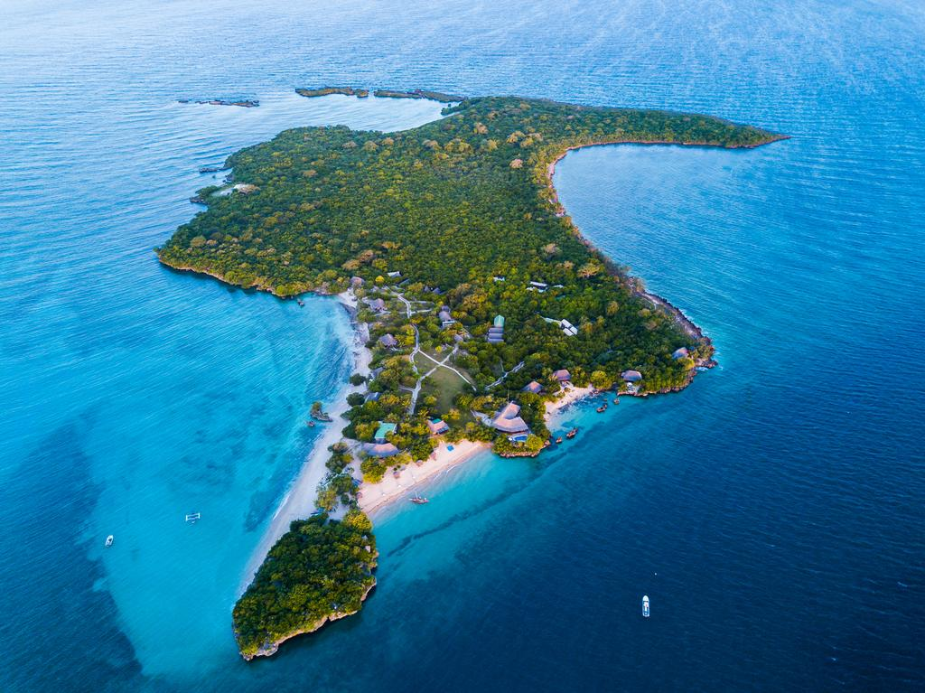
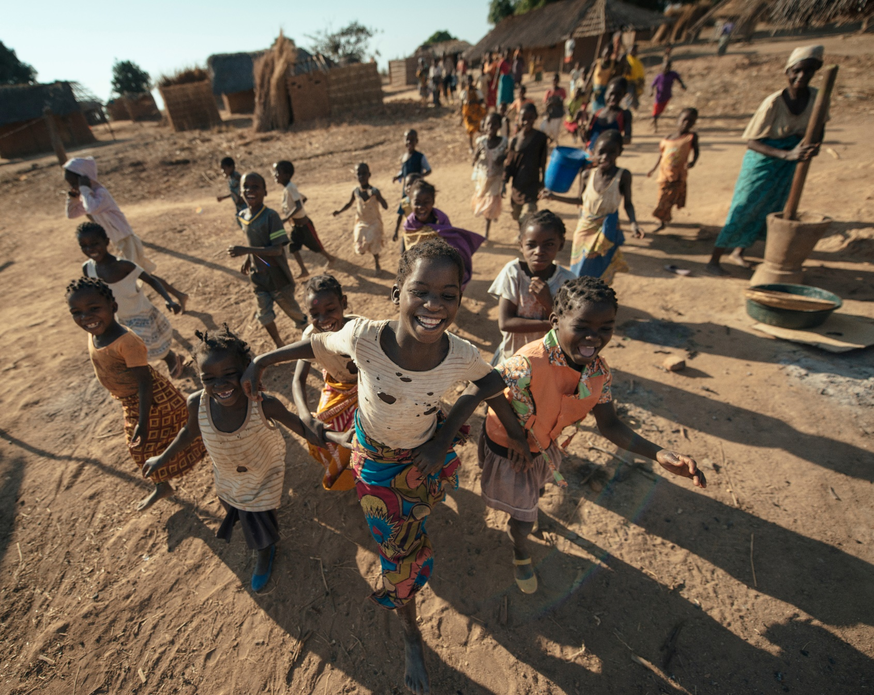
NATIONAL SYSTEM FOR CONSERVATION AREAS
The National System for Conservation Areas is made up of:
Conservation Areas Administration Bodies;
Administrator and Management Council in each Conservation area
The Funding Mechanisms for the conservation areas and;
Public-Private and community Partnership (concessions Contracts, Co-management agreements);
Institutions to provide assistance to Biodiversity Conservation;
Compensation for ecosystem Services (compensation fees, Carbon credits);
Conservation Areas Network.
Representing 25% of the country’s territory

Slide 2
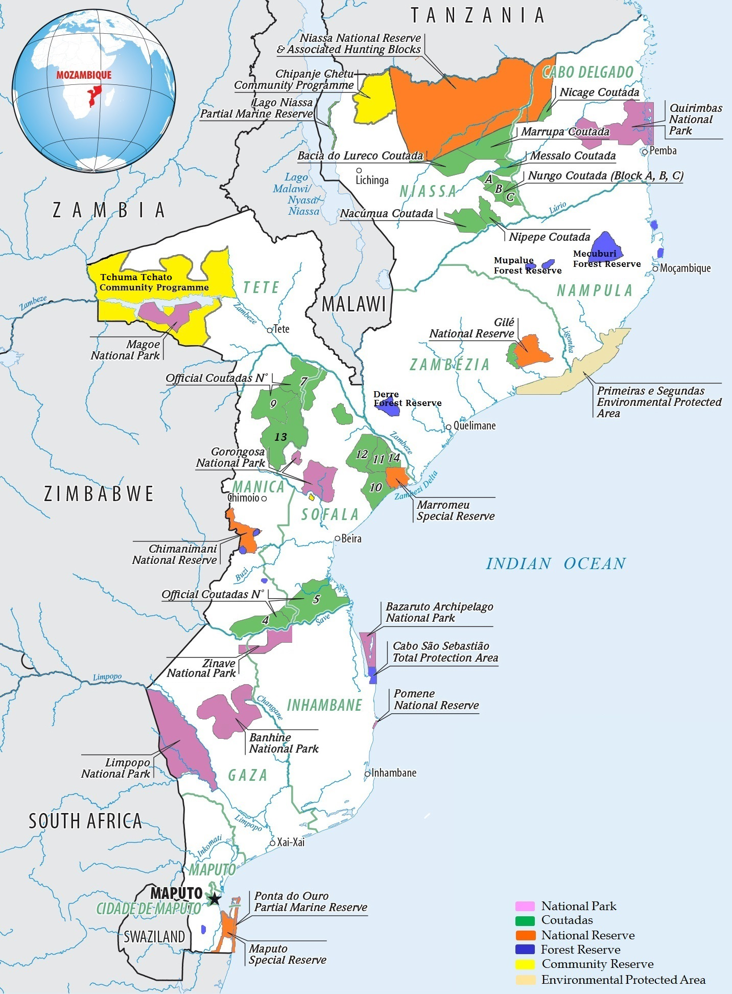
Conservation Areas Categories – Law for Protection, Conservation and Sustainable Use of Biological Diversity (16/2014 of 20th June)
Category | Conservation Area | # | (Sq Km)
Total Protection | Integral Natural Reserve
 | National Park | 9 | 50,797
 | Cultural Natural Monument
Sustainable Use | Special Reserve | 2 | 43,240
 | Environmental Protected Area | 2 | 16,642.6
 | Oficial Coutada | 20 | 57,304.6
 | Community Conservation Area | 3 | 31,838
 | Sanctuary | 1 | 439.00
 | Hunting Concession | 27 | 6788.4
 | Municipal Ecological Park | 1 | 5.6
 | To be Recategorised
 | National Reserve | 2 | 1,550
 | Ponta Do Ouro Marine Partial Reserve | 1 | 678
 |  | 68 | 209,283.2

Slide 3
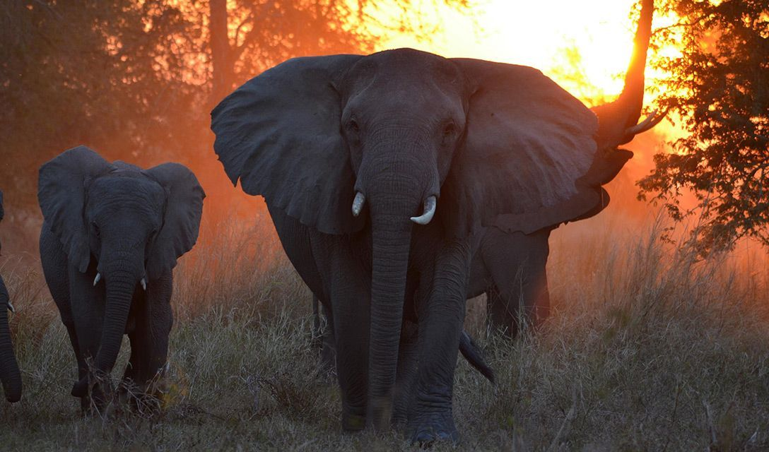
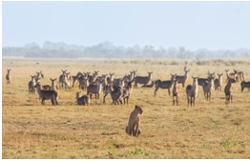
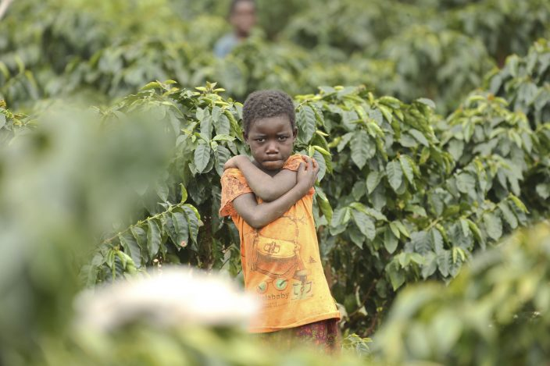
THANK YOU

