Slide 1
Conservation Trust Funds and the Private Sector:
Emerging Approaches to Conservation Finance
Wolfs Company
7th of October 2021

Slide 2
The biodiversity financing gap
Global biodiversity financing gap
USD 824 bn
“$44 trillion of economic value generation
– over half the world’s total GDP –
is moderately or highly dependent on nature and its services”
Private (14%)
Public & philanthropic (86%)
World Economic Forum (2020)
Global biodiversity finance
USD 143 bn
Deutz et al. (2020)

Slide 3
Growing private sector interest
From 35 return-seeking investors:
“70% [..] are planning substantially higher investments in conservation in 2021 compared to 2020”
Coalition for Private Investments in Conservation (2021)

Slide 4
Why do CTFs reach out to the private sector?
Mobilization of additional (long-term) funding and fund diversification
Increased and sustainable conservation impact tailored to local needs
Creation of synergies for the implementation of conservation activities

Slide 5
CTFs and the biodiversity financing gap
Global biodiversity financing gap
USD 824 bn
Some instruments CTFs have used to mobilize funds (last 10 years):
Carbon offsets
Private
Biodiversity offsets
Payments for ES
Earmarked fees
Fiscal transfers
Public &
philanthropic
Flow-through funds
Global biodiversity finance
USD 143 bn
Debt conversions
Donations
Deutz et al. (2020)
Source: Conservation Trust Funds 2020: Global Vision, Local Action

Slide 6
Diversity of financing mechanisms
Return-based investments
Economic instruments
Public financial management
Risk management
Financial efficiency
Grants and other transfers
Main mechanisms
Conservation Trust Funds 2020: Global Vision, Local Action (CFA, Wolfs Company & Aligning Visions)
(n=50)

Slide 7
Diversity of financing mechanisms
Return-based investments
Economic instruments
Public financial management
Emerging
mechanisms
Risk management
Risk management
Financial efficiency
Grants and other transfers
Conservation Trust Funds 2020: Global Vision, Local Action (CFA, Wolfs Company & Aligning Visions)
(n=50)

Slide 8
Fund deployment
Business and markets
Return-based investments
Partnerships
&
Innovation
Risk management
Grants and other transfers
Conservation Trust Funds 2020: Global Vision, Local Action (CFA, Wolfs Company & Aligning Visions)
Notes:
Speaker: Amílcar

Slide 9
Conservation Trust Funds 2020: Global Vision, Local Action
The report
Documenting and analyzing existing financial partnerships between CTFs and the private sector
In-depth interviews
CTFs
with relevant track record
Interviews
with international experts
Findings from
CTFs 2020: Global Vision, Local Action
CTF annual reports and websites
Input from CTF networks

Slide 10
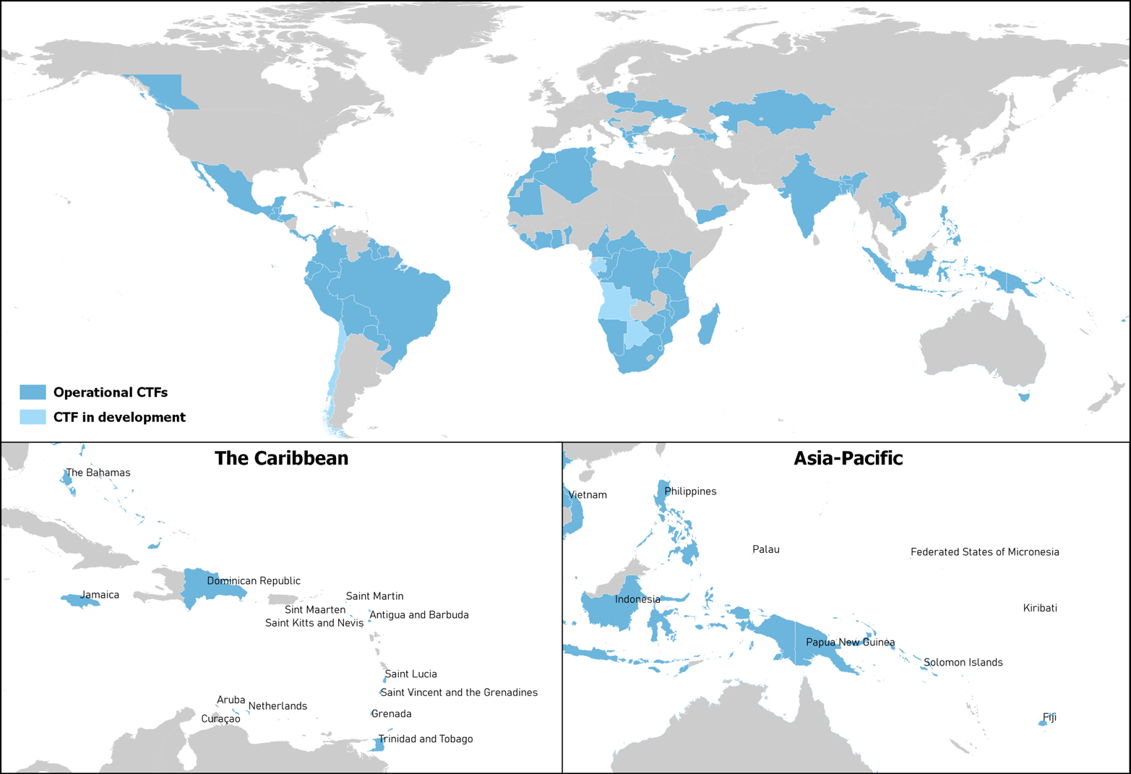
Conservation Trust Funds 2020: Global Vision, Local Action
CTFs
Notes:
List:
Coast Funds - Canada
CBF – Latin
FMCN
Fondo Acción
FUNBAM / FONAFIFO
MAR Fund
FTNS
FAPBM
BIOFUND
MMCT

Slide 11
Financial instruments in partnerships with the private sector
 | On the rise
 |  | Emerging
 |  |  | Concept stage
Well-established track record
Impact-only mechanisms | Grants
 | CSR investments: donations, earmarked revenues
Debt-based mechanisms | Loans (revolving loan funds)
 | Microcredits
 | Bonds
Equity-based mechanisms | Seed financing
 | Venture capital (VC)
 | (Public) equity investment
Market-based mechanisms | PES schemes, incl. carbon offsets
 | Biodiversity offsets
Hybrid mechanisms | Blended finance, guarantees, TAFs, pooled funds
Impact-only mechanisms | Grants
 | CSR investments: donations, earmarked revenues
Debt-based mechanisms | Loans (revolving loan funds)
 | Microcredits
 | Bonds
Equity-based mechanisms | Seed financing
 | Venture capital (VC)
 | (Public) equity investment
Market-based mechanisms | PES schemes, incl. carbon offsets
 | Biodiversity offsets
Hybrid mechanisms | Blended finance, guarantees, TAFs, pooled funds
Impact-only mechanisms | Grants
 | CSR investments: donations, earmarked revenues
Debt-based mechanisms | Loans (revolving loan funds)
 | Microcredits
 | Bonds
Equity-based mechanisms | Seed financing
 | Venture capital (VC)
 | (Public) equity investment
Market-based mechanisms | PES schemes, incl. carbon offsets
 | Biodiversity offsets
Hybrid mechanisms | Blended finance, guarantees, TAFs, pooled funds
Impact-only mechanisms | Grants
 | CSR investments: donations, earmarked revenues
Debt-based mechanisms | Loans (revolving loan funds)
 | Microcredits
 | Bonds
Equity-based mechanisms | Seed financing
 | Venture capital (VC)
 | (Public) equity investment
Market-based mechanisms | PES schemes, incl. carbon offsets
 | Biodiversity offsets
Hybrid mechanisms | Blended finance, guarantees, TAFs, pooled funds
Impact-only mechanisms | Grants
 | CSR investments: donations, earmarked revenues
Debt-based mechanisms | Loans (revolving loan funds)
 | Microcredits
 | Bonds
Equity-based mechanisms | Seed financing
 | Venture capital (VC)
 | (Public) equity investment
Market-based mechanisms | PES schemes, incl. carbon offsets
 | Biodiversity offsets
Hybrid mechanisms | Blended finance, guarantees, TAFs, pooled funds

Slide 12
Enabling attributes
General CTF attributes
Attributes of frontrunner CTFs
Trustworthy institutions: Legal independence and transparent procedures
Established financial management: Investment structures, ability to absorb risk, accountability and financial know-how
Established network: Connections with different actors and projects, and ability to create high-level partnerships
By-laws with independent governance bodies
Tangible connections with the private sector
Innovation-supportive board

Slide 13
Roles of CTFs in partnerships with the private sector
Policy influencer
Risk mitigator
Investor
Matchmaker
Incubator
Aggregator

Slide 14
Barriers
Financial & administrative
Perceptual & informational
Revenue potential and scale of projects
Technical capabilities
Limited understanding of each other‘s scope and needs
Legal & political
Socio-economic & environmental
Legal restrictions on CTFs
No legal requirements for company offsets
Competing areas of focus in impact regions
Limited private sector entities in some countries
Notes:
Financial & administrative
External:
Limited revenue-generating and growth potential of conservation activities
Investment opportunities are too small for investors and not worth the high transaction costs
Internal:
Perceptual & informational
Private sector’s limited understanding of its reliance on natural capital
Private sector’s lack of awareness of CTFs and their added value
Legal & political
Legal provisions prohibiting some CTFs to make specific types of financial transactions
Lack of legal requirements for companies to offset their adverse environmental impacts
Socioeconomic & environmental
Competing areas of focus in the impact regions (other issues such as healthcare)
Limited number of private sector entities in some countries

Slide 15
Building foundations
Build CTFs’ financial and business capabilities & partner with technical experts
Organize exchanges among CTFs and create guidelines for private sector engagement
Bring in board members/staff with private sector background
Active networking and exchange with the private sector
Involve external facilitators or catalyzers of partnerships
Cooperate with governments to shape legal frameworks
BRIDGE

Slide 16
Making choices
What is the…
partnership objective?
impact context?
CTF’s risk preference?
CTF’s financial flexibility?
mechanism’s technical complexity?
mechanism’s required capital investment size?
mechanism’s mission-alignment?
Objective / Context
Suitable instrument
Short-term capital for non-revenue-generating projects
Shaping the local business environment
Community-based conservation
Protected areas
Mission-aligned asset management
Private capital for conservation-positive businesses
CSR investments: donations, earmarked revenues
Grants & loans to SMEs, seed financing, venture capital
Microcredits, seed financing, PES, (voluntary) carbon offsets
Biodiversity offsets, park bonds
SRI & ESG investing
Pooled impact investment funds, stock indices, blended finance, green and blue bonds

Slide 17
Thank you!
Amílcar Guzmán Valladares
Partner
amilcar.guzman@wolfscompany.com
Joris van Pul
Consultant
joris.vanpul@wolfscompany.com
Charlotte Süring
Report author
www.wolfscompany.com
With the kind support of:

