Slide 1
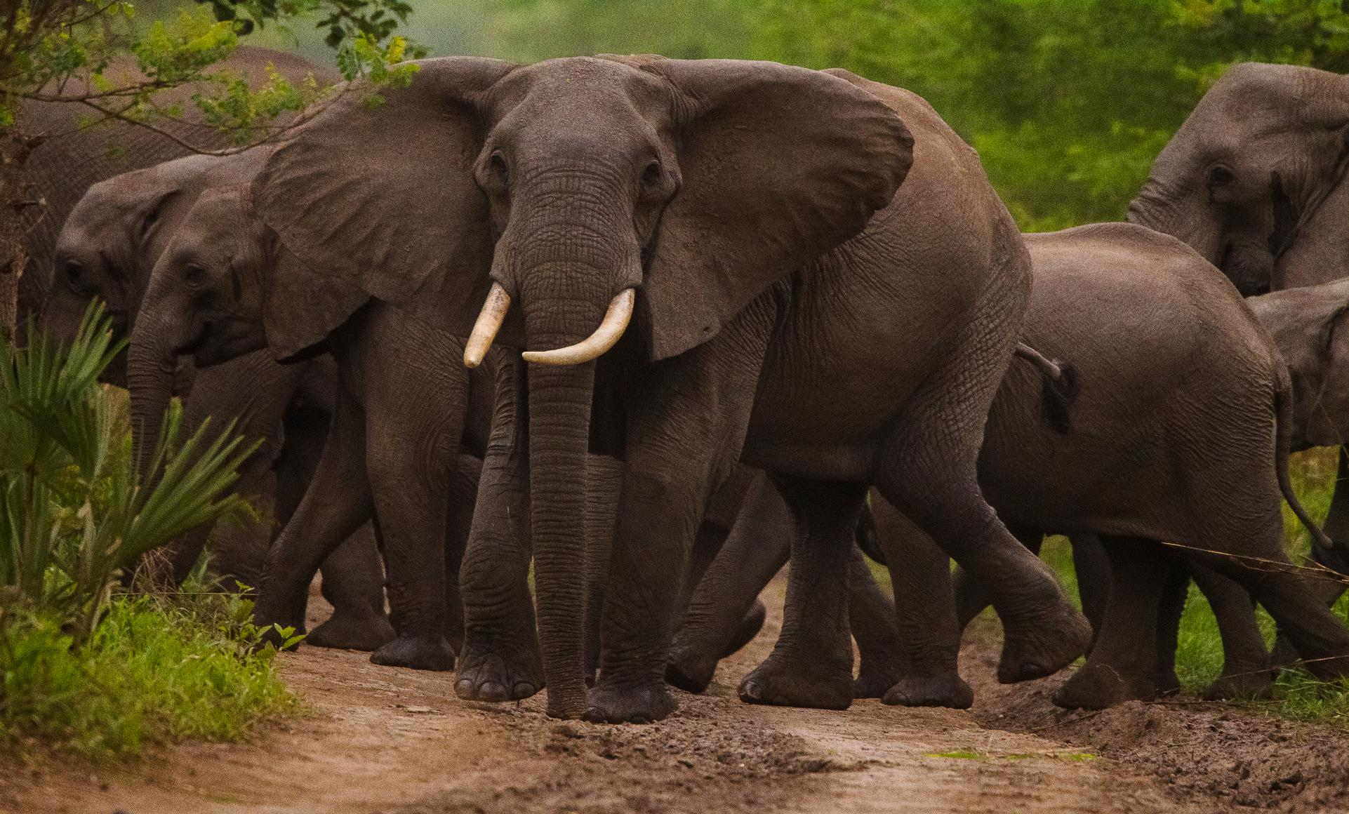
CAFE GENERAL ASSEMBLY
MAPUTO October | 2021
©ANAC

Slide 2
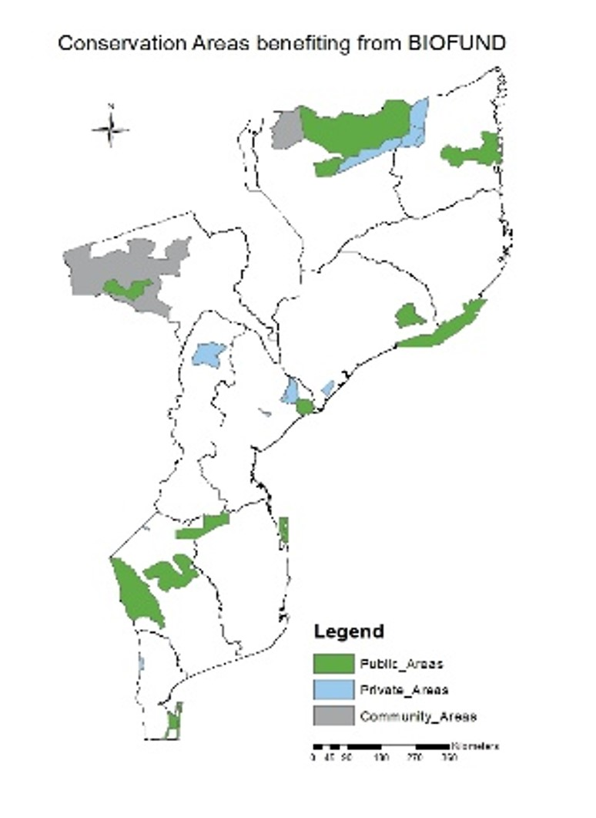
Basic Information
Basic Information
Year of Establishment | 2011
Total Endowment Value (USD) | $56.2M
Total Disbursements 2020 (USD) | $2.2M
Total Disbursements 2021 (January – June) | $2.07M
Current Staff Members | 28
Type and Number of beneficiaries 2021 | 31 Protected Areas (15 publicly-managed and 16 privately-managed areas)

Slide 3
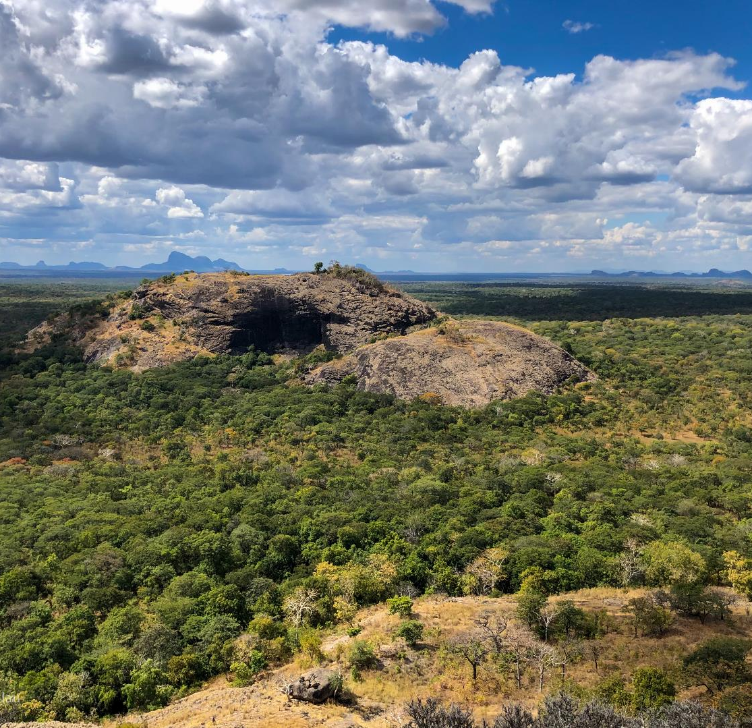
CTF Highlights since last CAFE Assembly
New Endowment Contributions to create 4 New Financing Windows:
US$ 12 M from the GEF
To support PAs with no other sources of funding;
To create a Basket Fund to support central level salaries of the PA Management Authority;
To support Private sector initiatives;
€2 M from AFD
New specific fund for rapid response to climate emergencies such as cyclones;
©Denise Nicolau

Slide 4
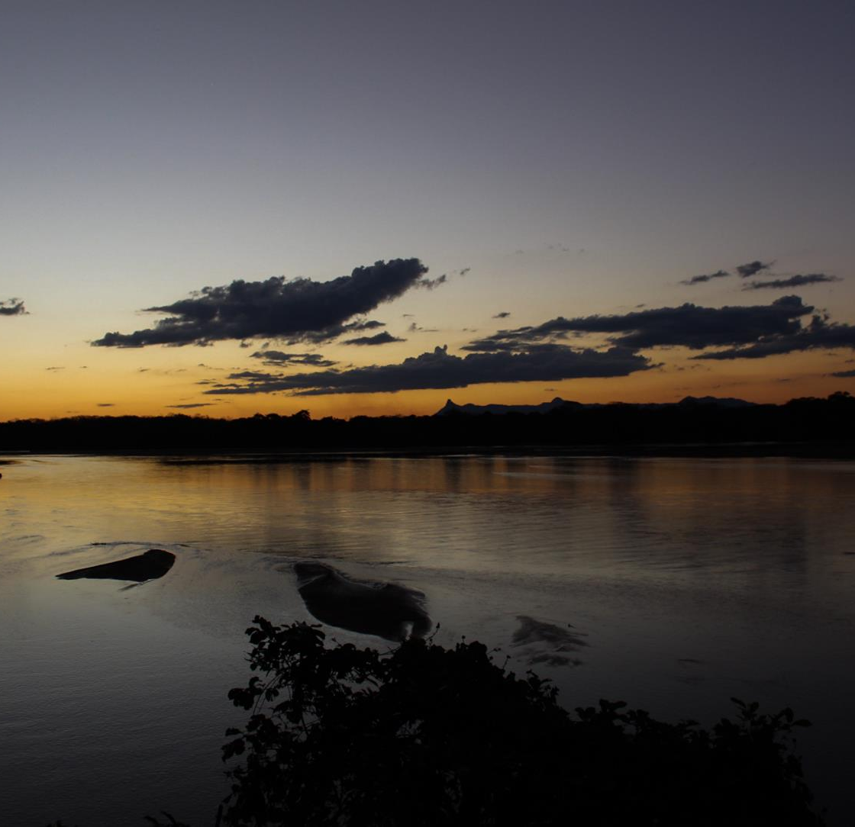
CTF Highlights since last CAFE Assembly
Created the Emergency Bio-Fund with US$ 3 M to help publicly- and privately-managed PAs to survive the loss of tourism revenues due to Covid -19
US$ 49 M+ raised in new pass – through funds for 5 different projects for the European Union, AFD/FFEM and the World Bank
Start of a national internship and scholarship program placing 144 recent graduates in the PAs for 6-12 months
©Denise Nicolau

Slide 5
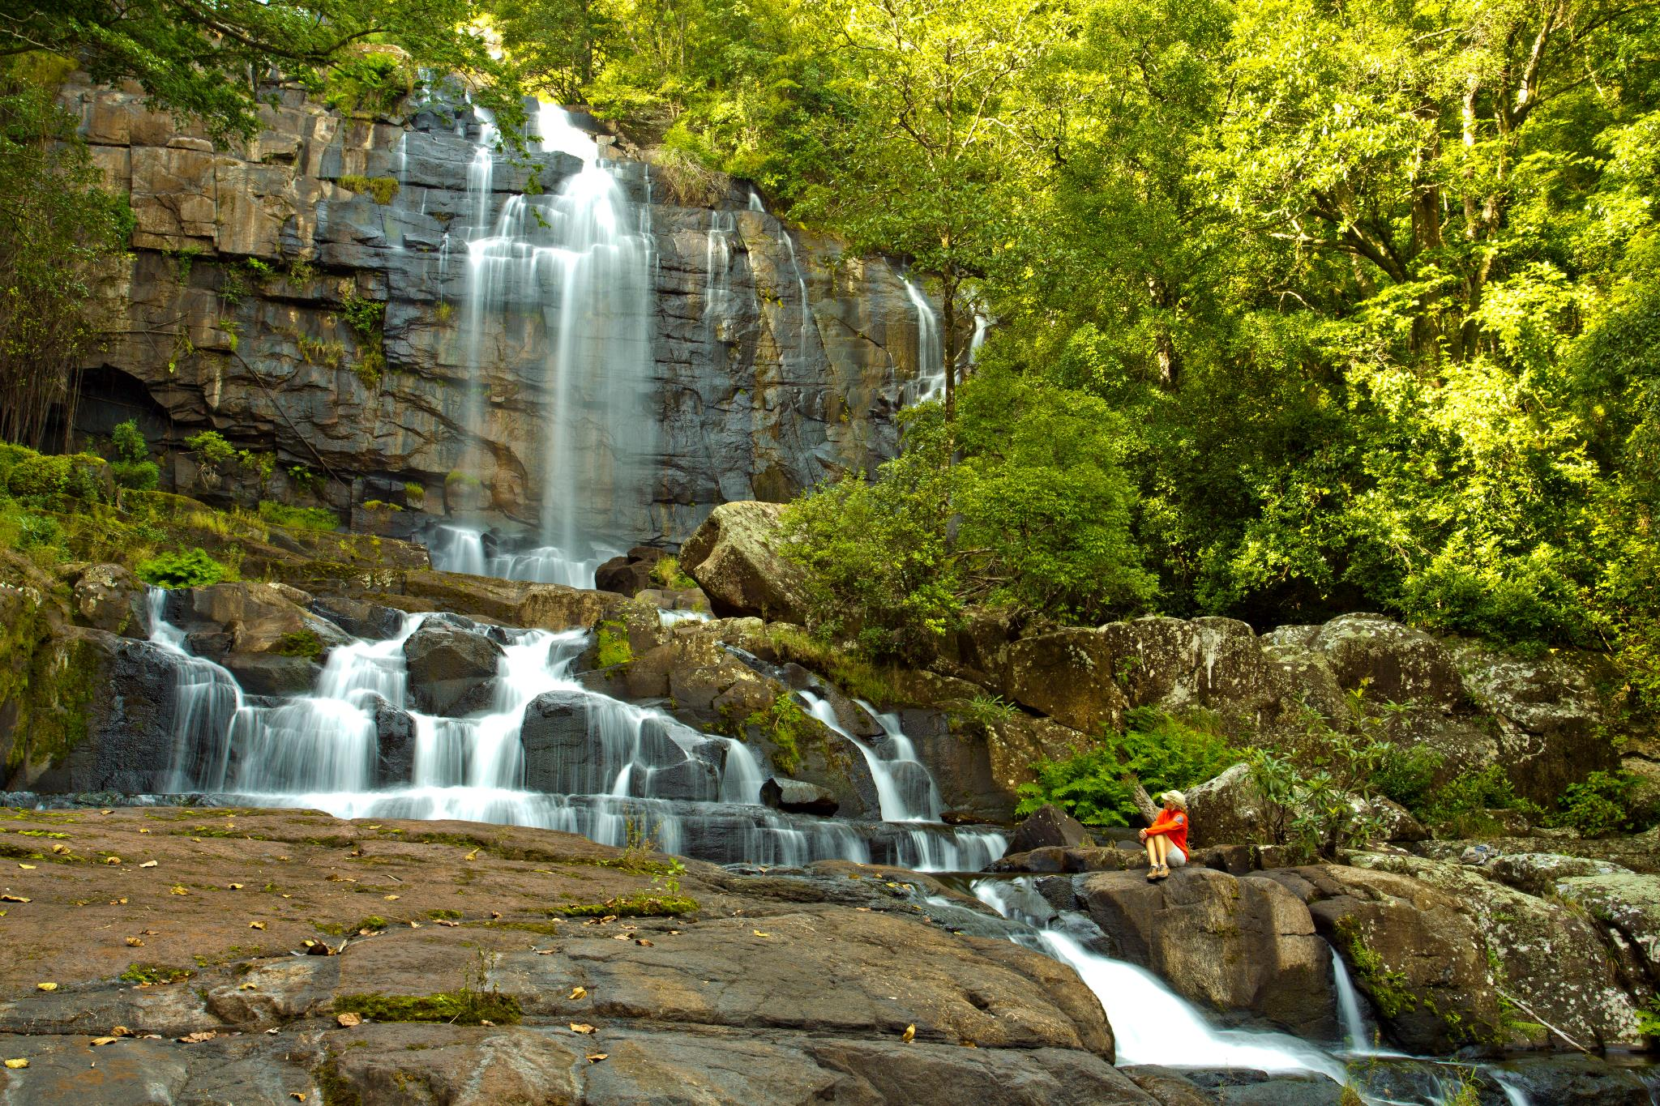
Av Tomás Nduda , n 1038
Tel.: +258 21 49 9958
Email: info@biofund.org.mz
Website: www.biofund.org.mz
©Bob Poole
©Denise Nicolau

