Slide 1
Environmental Conservation Trust of Uganda ECOTRUST
Mission: to conserve biological diversity and enhance social welfare by promoting innovative and sustainable environmental management Goal: Provide long-term sustained funding for the conservation of biodiversity and environmental management in Uganda
Blended Model: Donor financing, PES payments, microfinance & Income generation from Community – owned enterprises
Currently Operational in Mt. Elgon and the Albertine Rift, Mpologoma with plans to cover the whole of Uganda

Slide 2
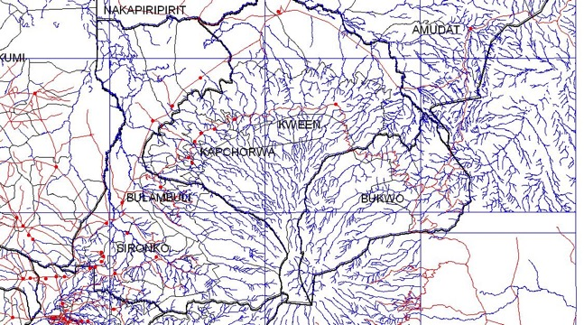

Slide 3
Mt. Elgon
Climate-smart crop diversification
Improved crop varieties, crop rotation
organic fertilizer use
Incentives for Ecosystem Services from Agriculture (IES)
Soil conservation measures
Construction of terraces and planting of grass strips along contour lines to increase soil stability, slow water run- off and soil loss.
Gravity fed irrigation
.
ECOSYSTEM THREATS
Loss of wetland and forest biodiversity
Deforestation and forest fragmentation
High population pressure
Riparian habitat encroachment for cultivation, sand minding and re-channelling of water.
Soil erosion from steep slope and river bank cultivation
Intensive subsistence and commercial agricultural practices
Over grazing
Vulnerability to climate change
BEST PRACTICES
Reforestation and protection of forest habitats
Restoration of degraded wetlands and development of sustainable wetland agriculture
Development of agroforestry and live fencing
Climate-smart sustainable agricultural practices such as:
Soil & water conservation measures
Organic fertilizer and manure
Crop rotation and diversification
Woodlot management
Improved livestock breeds and fodder
Improved water management, such as gravity flow systems
Agroforestry
Afforestation of live fencing and agroforestry within coffee plantations
Wetland
Restoration of papyrus along lake edge to increase filtration against chemical residues and reduce sedimentation
INCENTIVES REQUIRED
Capital to support:
Forest and wetland restoration and protection
Agroforestry development
Improved sustainable agricultural practices
Soil erosion and improved water management measures
Stronger monitoring and enforcement of encroachment (by laws, stakeholder platforms)
Technical assistance and support to farmers to:
Improve climate smart agroforestry and agricultural practices
Implement soil erosion control measures
Improve water irrigation and storage infrastructure
Access to higher-value markets through coffee certification, certified timber
Development of alternative livelihoods (micro financing)

Slide 4
Landscape Restoration as a Business
0 to 5 YRS; Bilateral & Multilateral donors (Deployed to de-risk smallholder – led investments)
5 to 15 YRS: Farmers able to use their PES agreements as collateral for loans from the SACCOs
7 to 25 plus YRS: Private Sector off takers (income from Sale of timber & non timber forest products)
3 to 15 YRS: ES Offsetting partners. Small but predictable Ex-ante performance - based payments are used to create a credit history that makes the landholders attractive to loan finance

Slide 5
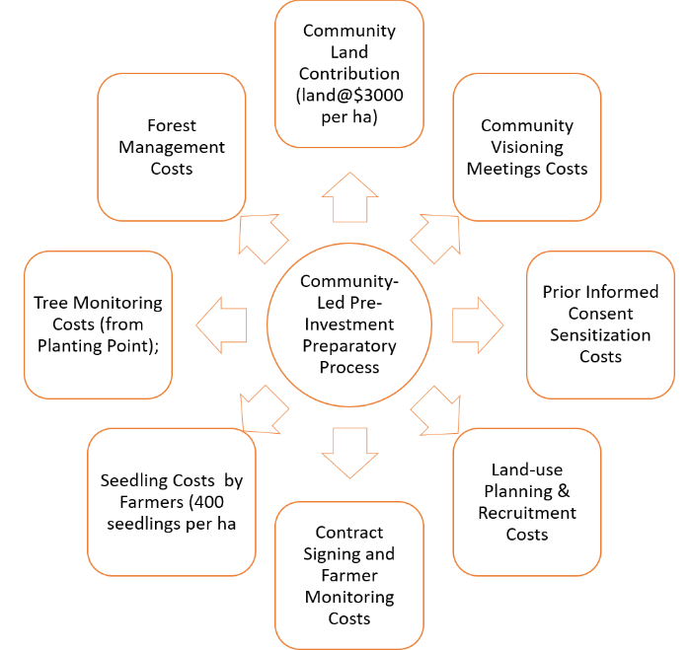
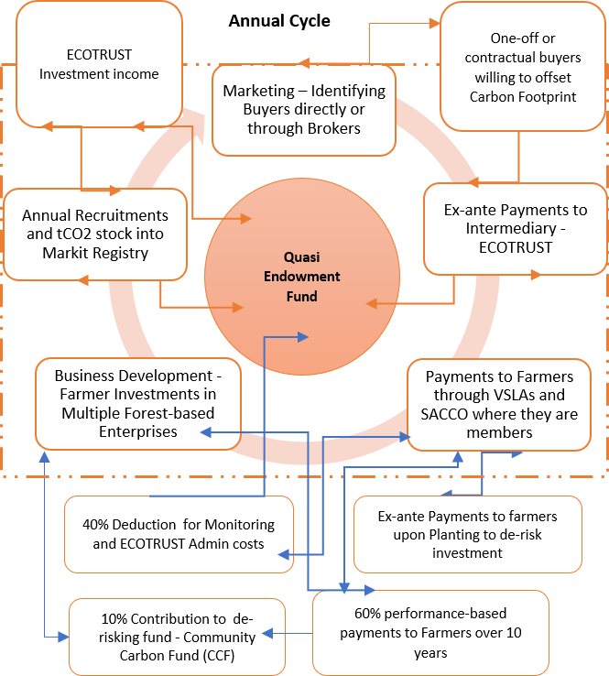
Landscape Restoration as a Business – Transforming Smallholder Investment Horizons
Programmes of Activities
Queen Elizabeth
Budongo / Bugoma
Rwenzori
Elgon
Mpologoma
Blended Financing to De-Risk Landscape restoration
Landholder Engagements
Commoditization & Aggregation of Environmental Services
Trust Fund management Sales and Payments
Community Financing
Biophysical Assessments, Tech specs, certification, validation & verification
Business case development for Private sector investments – Off-setting, In-setting, Off-taking
ECOTRUST Internal Revenue
Commoditization and Aggregation of Accruing Environmental Services into Markit Registry
Public/Donor Financing
Co-Benefits linked to the mobilization of Public Financing (other business lines)
Private Sector Financing
Using public financing to scale out (Geographically) & Scale up

Slide 6
Thank you

